Slide 1
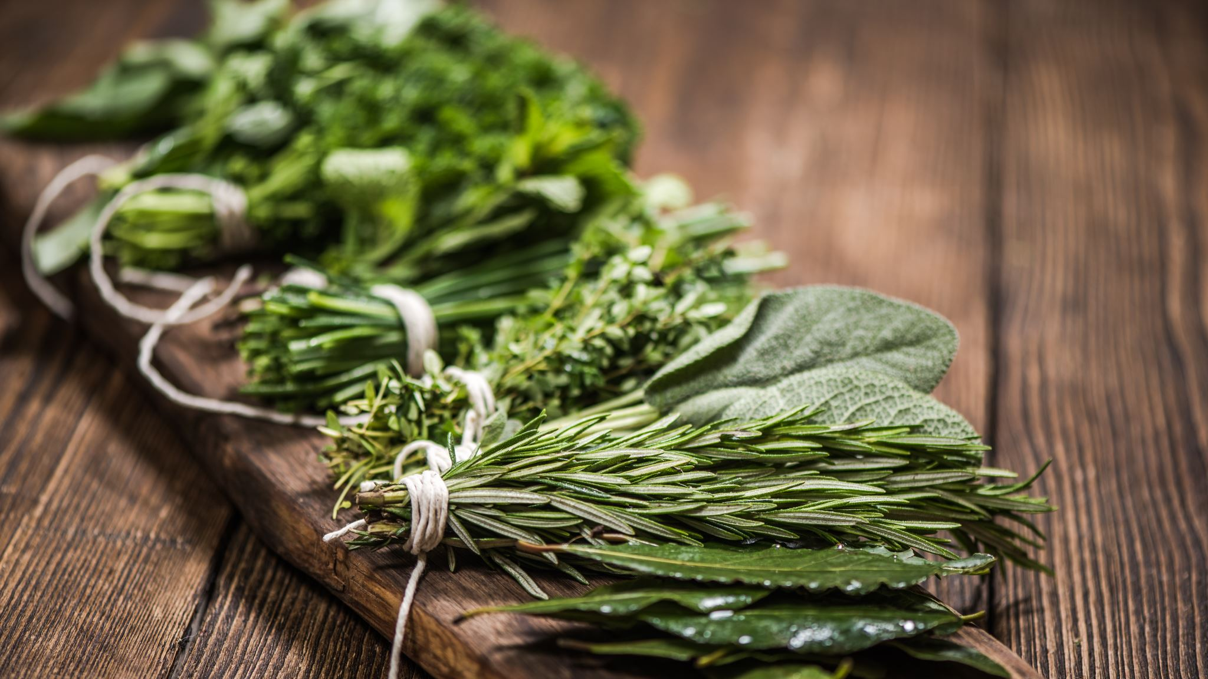
‘Sustainable food choices for students’
Your name: Luke Hammond

Slide 2
What is sustainable food?
Find a reliable definition and give references
“Sustainability is the practice of using natural resources responsibly today, so they are available for future generations tomorrow.”
National geographic (2022) Sustainability. Available from: https://education.nationalgeographic.org/resource/sustainability [Accessed 25 October 2022]
When you tie it in with food it means to grow and eat food available today but not affect the growth or impede the food for future generations.

Slide 3
Sustainable food choices for students
What are UK students’ key values when it comes to food? Give supporting references
“Dietary analyses revealed four major dietary patterns: ‘vegetarian’; ‘snacking’; ‘health-conscious’; and ‘convenience, red meat & alcohol’.”
Female students leaned more towards the ‘vegetarian’ food habits whereas the male students fit the ‘convenience, red meat & alcohol’, however the students who were more capable of cooking went towards a more ‘vegetarian’ and ‘health conscious’ patterns
“University policy to improve students’ diets should incorporate efforts to promote student engagement in cooking and food preparation, and increased availability of low-cost healthier food items.”
E. F. Sprake (2018) Dietary patterns of university students in the UK: a cross-sectional study. Available from: https://nutritionj.biomedcentral.com/articles/10.1186/s12937-018-0398-y [Accessed 25 October 2022]

Slide 4
Sustainable food choices for students
What might non-students think about students’ food choices? Give supporting references
It is among the universities best interest to help develop and push university students to eating healthy, the transition from moving away from home with freedom of choice to choose food, many students eat rather unhealthy and therefore, never develop an understanding of the importance of healthy as well as sustainable food. This can result in a number of eating disorders.
In addition to food choice, students may start having irregular meals as well as in increase in unhealthy snacks.
“…the most common factors that are reported as barriers to a healthy diet are time constraints, the high price of food items, and their availability, followed by the lack of motivation in food preparation…” (Sogari, G (2018) College Students and Eating Habits: A Study Using An Ecological Model for Healthy Behavior. Available from: https://www.ncbi.nlm.nih.gov/pmc/articles/PMC6315356/ [Accessed 25 October 2022]

Slide 5
Sustainable food choices for students
From your experience, what external circumstances could influence students’ choices about foods?
Variables I have experienced are time constraints as well as money difficulties. Sometimes there are late lectures or a lot of work to get through resulting in either a quick dinner such as noodles or some unhealthy snacks to fill up before having time to make dinner.
In addition to this, a bad sleep schedule and early lectures usually means the first meal I have in my day is lunch.
Another factor is living with my partner, as we have shared shopping we have the same dinner, therefore, we need to compromise on what we decide to eat, taking into consideration the others interests as well as what they may desire that week.

Slide 6
Questions for interview/ focus group
Starter:
What did you have breakfast today?
Did you know this was going to be your breakfast this morning or did you decide when preparing?
Transition to main questions:
What are some of your favourite apps to use?
What is it about those apps you enjoy?
Have you noticed a change in your eating habits since becoming an adult or moving out? - could you perhaps give a reason as to why?
Main questions:
What does the word sustainable mean to you?
Could you give an example of a sustainable piece of food?
– this is the definition given by national geographic, “Sustainability is the practice of using natural resources responsibly today, so they are available for future generations tomorrow.” – hearing this, do you think this fits with your answer?
What factors would you say affect your decision when making food?
What do you think would push you to eat sustainably more often?
Do you believe you have a good understanding of what makes a healthy & balanced meal?
Currently in society do you believe there is enough awareness around sustainable & healthy eating?
Does your university do enough to make people aware of sustainable food and push people towards them?
Transition to ending:
After answering these questions, do you have any opinions or thoughts on the matter you would like to share?

